Slide 1
OBJECT ORIENTED PROGRAMMING
PRESENTED BY: Sumna Imran
Final year student
UBIT Department – Karachi university

Slide 2
Today’s Topics:
What is Object Orientated Programming ?
Why it was invented?
Pillars of OOPS.
Inheritance.
Polymorphism.
Abstraction.
Encapsulation.

Slide 3
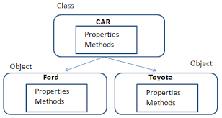
What is Object Orientated Programming ?
Object Oriented programming (OOP) is a programming paradigm that relies on the concept of classes and objects. It is used to structure a software program into simple, reusable pieces of code blueprints (usually called classes), which are used to create individual instances of objects. There are many object-oriented programming languages including JavaScript, C++, Java, and Python.
Class is a user-defined datatype that has its own data members and member functions whereas an object is an instance of class by which we can access the data members and member functions of the class.
For example: Ford and Toyota share certain similar features and hence can be grouped to form the Object of the Class Car.

Slide 4
Why it was invented?
The OOP concept was basically designed to overcome the drawback of the above programming methodologies, which were not so close to real-world applications. The demand was increased, but still, conventional methods were used. This new approach brought a revolution in the programming methodology field. Object-oriented programming (OOP) is nothing but that which allows the writing of programs with the help of certain classes and real-time objects. We can say that this approach is very close to the real-world and its applications because the state and behavior of these classes and objects are almost the same as real-world objects.

Slide 5
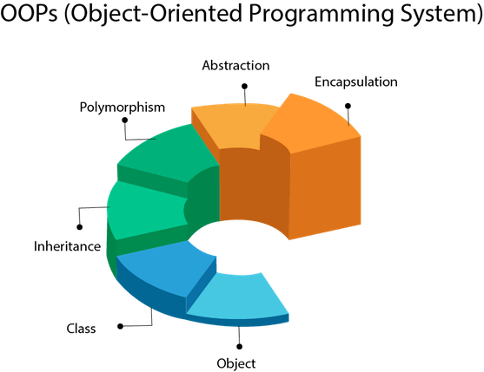
Pillars of OOPS.
There are four pillars:
Inheritance.
Polymorphism.
Abstraction.
Encapsulation.

Slide 6
Inheritance
Inherit: To receive a quality, characteristic, etc., from your parents or family.
As you see the definition above, inheritance allows us to define a class that inherits methods and properties from another class. Let’s say you need a new class with little or no modification, and you then apply this concept. The base class is called the parent class, and the derived class is known as a child.
Types of inheritance: There are five types of inheritance in python programming:
1). Single inheritance 2). Multiple inheritances 3). Multilevel inheritance 4). Hierarchical inheritance 5). Hybrid inheritance

Slide 7
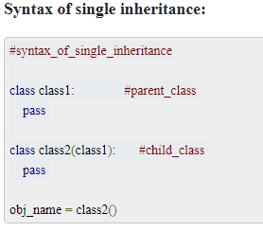
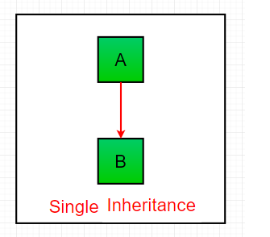
1)Single Inheritance:
Single inheritance: When child class is derived from only one parent class. This is called single inheritance.

Slide 8
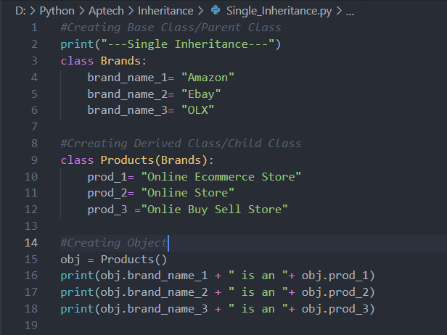
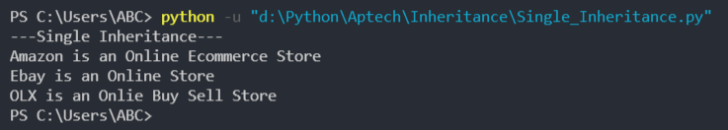
Single Inheritance Example:

Slide 9
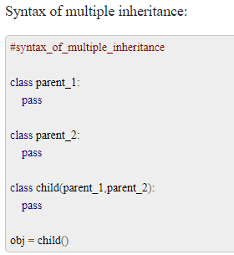
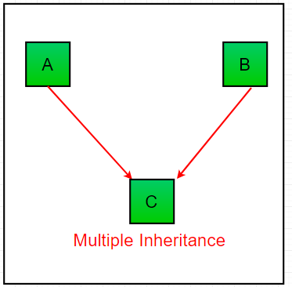
2)Multiple Inheritance:
Multiple Inheritance: When child class is derived or inherited from more than one parent class. This is called multiple inheritance. In multiple inheritance, we have two parent classes/base classes and one child class that inherits both parent classes properties.

Slide 10
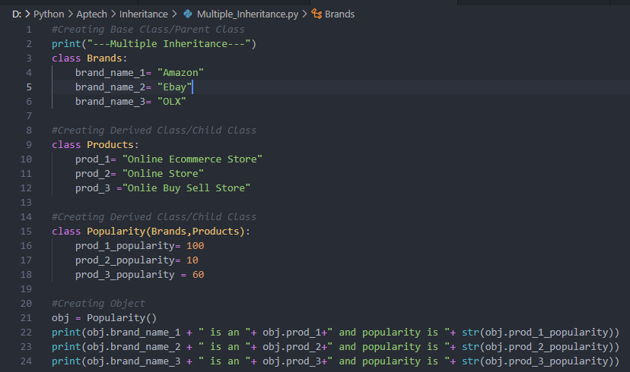

Multiple Inheritance Example:

Slide 11
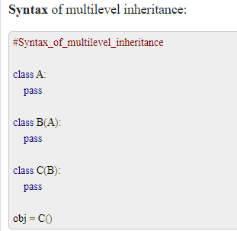
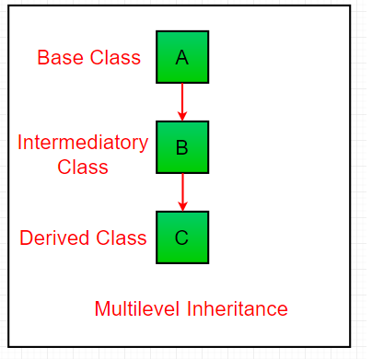
3)Multilevel Inheritance:
Multilevel Inheritance: In multilevel inheritance, we have one parent class and child class that is derived or inherited from that parent class. We have a grand-child class that is derived from the child class. See the below-given flow diagram to understand more clearly.

Slide 12
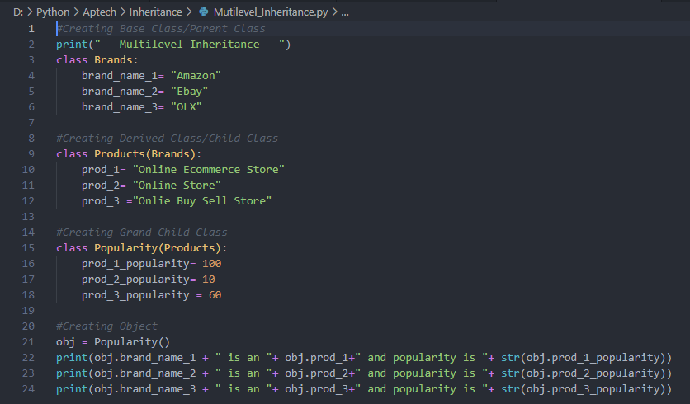

Multilevel Inheritance Example:

Slide 13
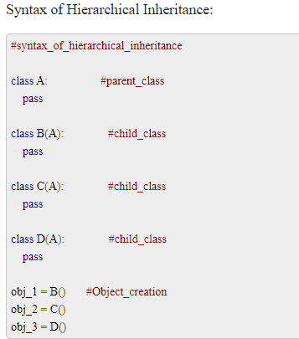
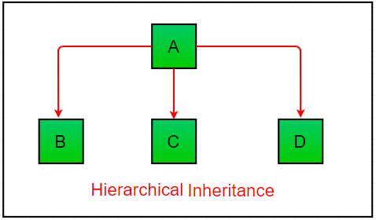
4)Hierarchical inheritance:
Hierarchical inheritance: When we derive or inherit more than one child class from one(same) parent class. Then this type of inheritance is called hierarchical inheritance.

Slide 14
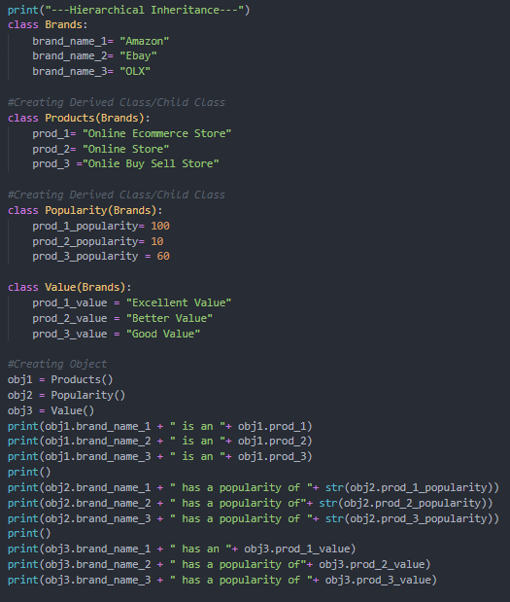
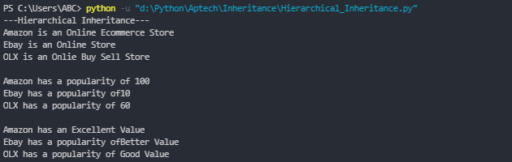
Hierarchical inheritance Example:

Slide 15
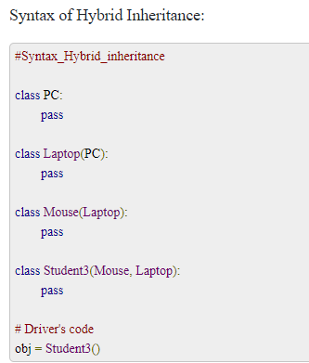
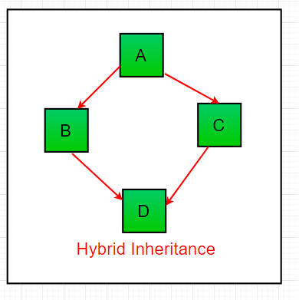
5)Hybrid Inheritance:
Hybrid Inheritance: Hybrid inheritance satisfies more than one form of inheritance ie. It may be consists of all types of inheritance that we have done above. It is not wrong if we say Hybrid Inheritance is the combinations of simple, multiple, multilevel and hierarchical inheritance. This type of inheritance is very helpful if we want to use concepts of inheritance without any limitations according to our requirements.
Note: There is no sequence in Hybrid inheritance that which class will inherit which particular class. You can use it according to your requirements.

Slide 16
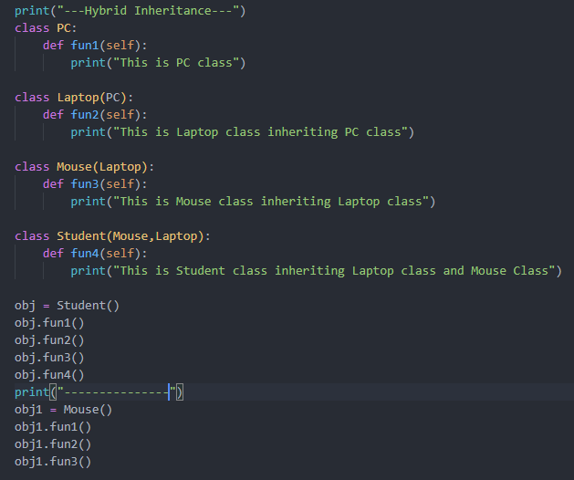
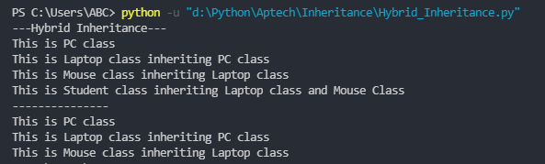
Hybrid Inheritance Example:

Slide 17
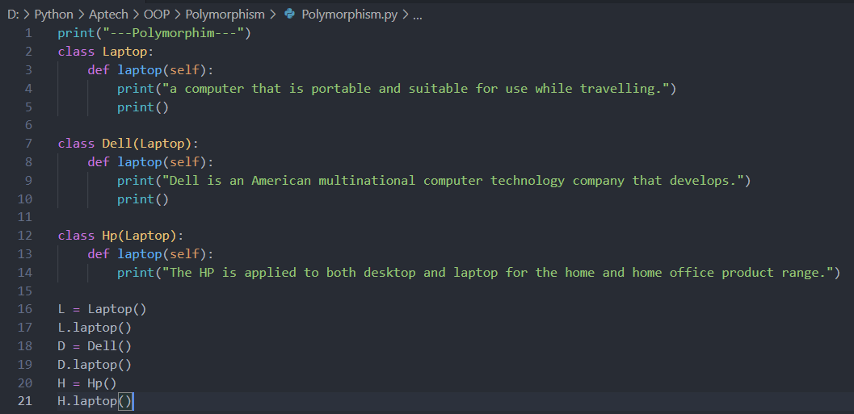
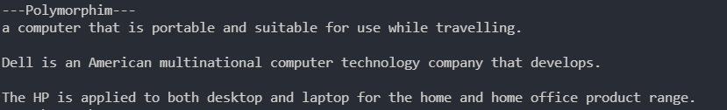
POLYMORPHISM
Polymorphism in Python is the ability of an object to take many forms. In simple words, polymorphism allows us to perform the same action in many different ways. In polymorphism, a method can process objects differently depending on the class type or data type.

Slide 18
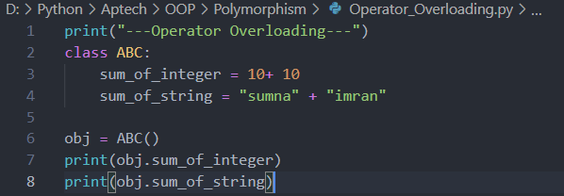

Types of Polymorphism:
There are 4 types of Polymorphism: 1). Operator Overloading 2). Method Overriding in Inheritance (user-defined) 3). Method Overriding (in-built) 4). Method Overloading
(i). Operator Overloading: We all know that plus (+) operator in python is used for the addition of elements in mathematics. But it is also used for other operations also. The process of using same operator for different use is called Operator Overloading.

Slide 19
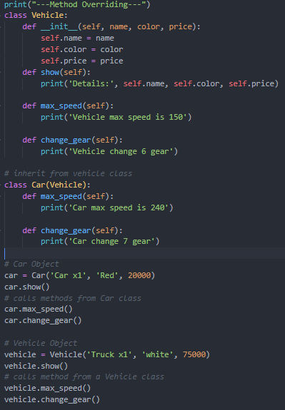
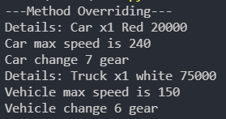
ii). Method Overriding (Inheritance): When we have method defined in parent class and also in child class with same parameter and same method name. To enhance the functionality of method in child class is called method overriding in python. See below given example to understand the concept of method overriding.

Slide 20
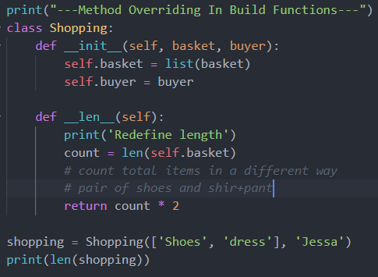

(iii). Method Overriding (in inbuilt – functions): There are some inbuilt methods of python that are used or satisfy the rule of method overriding.
For example, we can change or extend the built-in functions such as len(),abs(), divmod() by redefining them in our class.

Slide 21
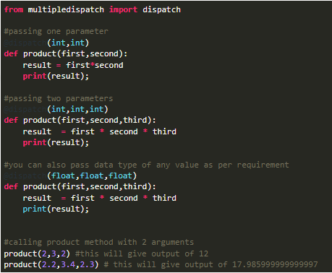
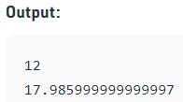
iv). Method Overloading: Like other languages (for example, method overloading in C++) do, python does not support method overloading by default. But there are different ways to achieve method overloading in Python.
The problem with method overloading in Python is that we may overload the methods but can only use the latest defined method.
Overloading in python can be achieved by Using Multiple Dispatch Decorator Multiple Dispatch Decorator Can be installed by:
For more on method overloading visit https://www.geeksforgeeks.org/python-method-overloading/

Slide 22
Abstraction
Abstraction is used to hide the internal functionality of the function from the users. The users only interact with the basic implementation of the function, but inner working is hidden. User is familiar with that "what function does" but they don't know "how it does.“
In simple words, we all use the smartphone and very much familiar with its functions such as camera, voice-recorder, call-dialing, etc., but we don't know how these operations are happening in the background. Let's take another example - When we use the TV remote to increase the volume. We don't know how pressing a key increases the volume of the TV. We only know to press the "+" button to increase the volume.
Data abstraction in python and data encapsulation in python programming are related to each other. The main point that is necessary here to note is that data abstraction is only possible to achieve through encapsulation.
Encapsulation means storing or placing data in a single place to make it easily readable and compact in one place. Whereas data abstraction in python programming means to hide internal functionalities that are performing on the application using codes and to show only essential information (class attributes).

Slide 23
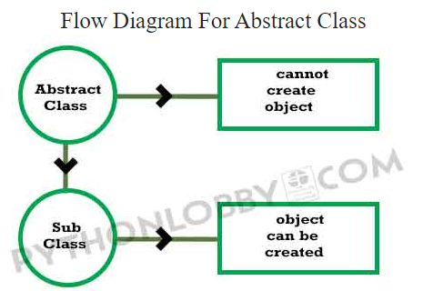
More On Abstraction:
Abstract Class: Abstract class in python programming is the class that contains one or more abstract methods. These types of classes in python are called abstract classes. Abstract methods are the methods that have an empty body or we can say that abstract methods have the only declaration but it doesn’t have any functional implementation.
Important: Abstract classes cannot be instantiated directly. We need subclass inheriting abstract class to instantiate. But before creating the object or instantiating the subclass we need to provide implementations for abstract methods.

Slide 24
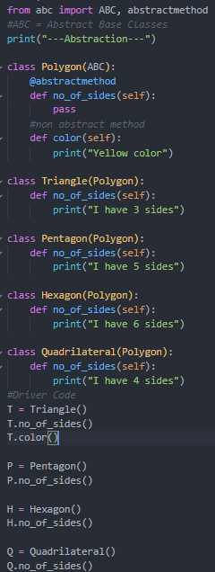
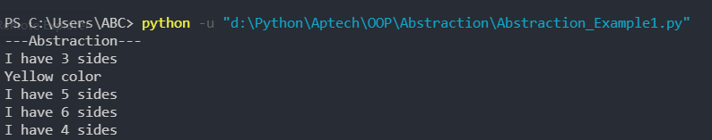
Abstraction Example:
Unlike the other high-level language, Python doesn't provide the abstract class itself. We need to import the abc module, which provides the base for defining Abstract Base classes (ABC). The ABC works by decorating methods of the base class as abstract. It registers concrete classes as the implementation of the abstract base. We use the @abstractmethod decorator to define an abstract method or if we don't provide the definition to the method, it automatically becomes the abstract method.

Slide 25
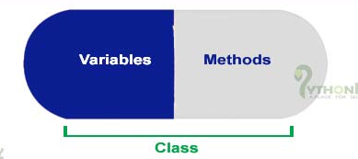
Encapsulation
Encapsulation: To enclose something in or as if in a capsule. Encapsulation in python is very small concept. By encapsulation we mean the gathering of code or data and methods operating on that data or code inside a single component and to stop the access of some of our class components.
In easy way, encapsulation is just the way to place your code at single place in such a way that it should be compact and restricted from the outside world to access protected or restricted data.
Above given image is the image of capsule. Like in capsule all the medicine content is collected and packed inside a small area. Just same like that capsule, encapsulation implements. Encapsulation in python collects its code in single area. Programs written using classes concept is the best example to achieve encapsulation in python

Slide 26
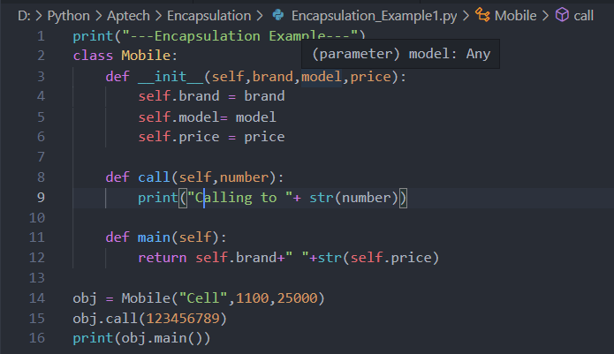
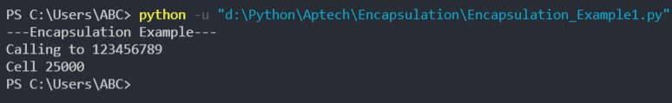
Encapsulation Example:

Slide 27
More On Encapsulation:
Using encapsulation, we can hide an object’s internal representation from the outside. This is called information hiding.
Also, encapsulation allows us to restrict accessing variables and methods directly and prevent accidental data modification by creating private data members and methods within a class.
Encapsulation is a way to can restrict access to methods and variables from outside of class. Whenever we are working with the class and dealing with sensitive data, providing access to all variables used within the class is not a good choice.

Slide 28
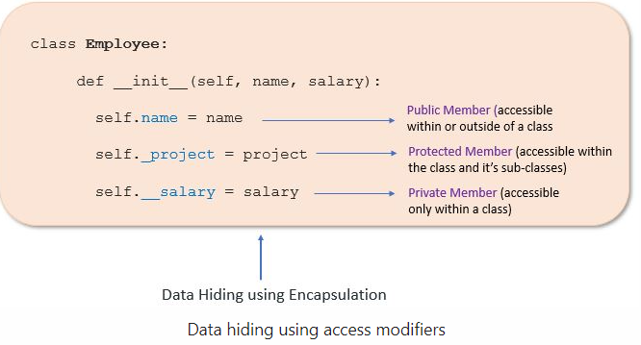
Access Modifiers in Python:
Encapsulation can be achieved by declaring the data members and methods of a class either as private or protected. But In Python, we don’t have direct access modifiers like public, private, and protected. We can achieve this by using single underscore and double underscores.
Access modifiers limit access to the variables and methods of a class. Python provides three types of access modifiers private, public, and protected.
Public Member: Accessible anywhere from outside of the class.
Private Member: Accessible within the class
Protected Member: Accessible within the class and its sub-classes

Slide 29
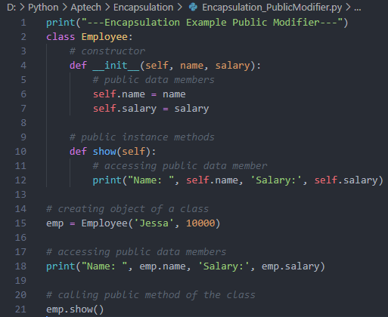

Public Member:
Public data members are accessible within and outside of a class. All member variables of the class are by default public.

Slide 30
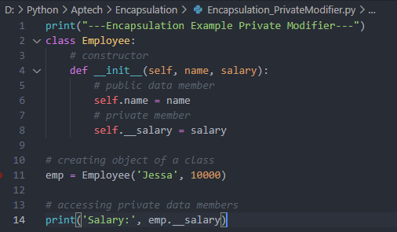

Private Member:
We can protect variables in the class by marking them private. To define a private variable add two underscores as a prefix at the start of a variable name.
Private members are accessible only within the class, and we can’t access them directly from the class objects.
the salary is a private variable. As you know, we can’t access the private variable from the outside of that class.

Slide 31
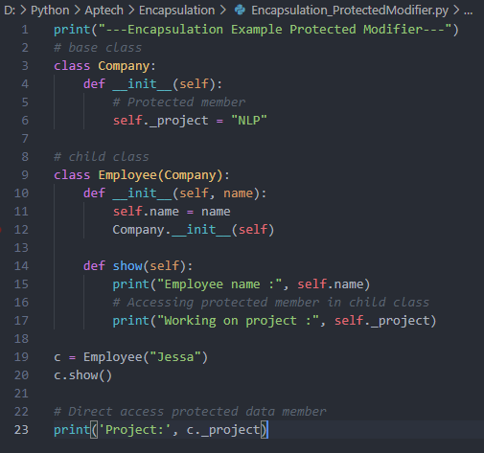

Protected Member:
Protected members are accessible within the class and also available to its sub-classes. To define a protected member, prefix the member name with a single underscore. Protected data members are used when you implement inheritance and want to allow data members access to only child classes.

Slide 32
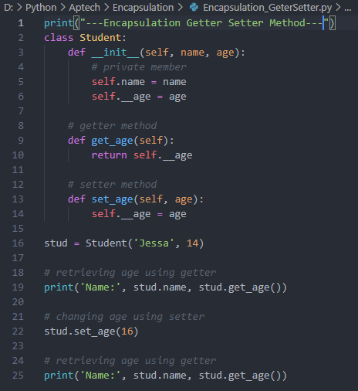

Getters and Setters in Python:
To implement proper encapsulation in Python, we need to use setters and getters. The primary purpose of using getters and setters in object-oriented programs is to ensure data encapsulation. Use the getter method to access data members and the setter methods to modify the data members.

Slide 33

THANK YOU FOR YOUR ATTENTION!

